Slide 1
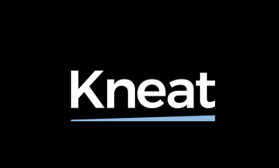


Kneat Solutions: Ireland Gender Pay
Gap Report 2025/26

Slide 2

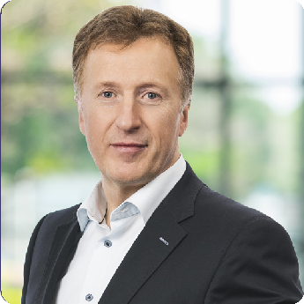
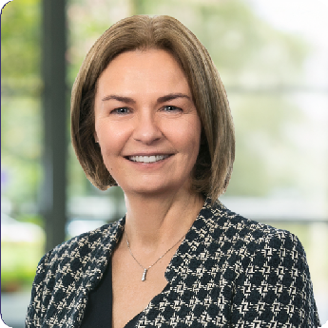
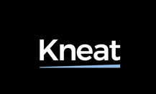
Foreword
Our Gender Pay Gap Report for 2025/2026
Kneat’s mission is to enable regulated organizations to move from paper- based validation to intelligent, digitized, paperless solutions. In Ireland, we are proud to employ over 250 talented people predominantly in Software Development, Operations, and Business Support services.
Diversity and Inclusion remain a key pillar of our Business and People Strategy. We want team members to feel a sense of belonging and identify with our mission. We are pleased to share our 2025/26 Gender Pay Gap Report in line with the Gender Pay Gap Information Act 2021.
Female gender representation across our workforce is 33%. We have female team members represented at all levels of the organization. As a software company, we face ongoing industry challenges in increasing female participation within the STEM sector.
We remain focused on our key strategies of attracting, retaining, and developing exceptional female talent. Our partnerships with educational institutions and community organizations are key to encouraging greater female representation.
In reading this report, we hope you appreciate the challenges we face and our continued commitment to building an inclusive workplace at Kneat –
one where every team member has the opportunity to grow, thrive, and contribute to our shared success.
Eddie Ryan Chief Executive Officer
Fiona McCarthy
Chief People & Culture Officer
Copyright ©2025. All rights reserved.
2

Slide 3




Our Gender Pay Gap Data
Gender Pay Gap Data
Female Employees | 94
Male Employees | 187
Median Gender Pay Gap Full-time employees | 13%
Mean Gender Pay Gap Full-time employees | 10%
Median Bonus Pay Gap Full-time employees* | 47%
Mean Bonus Pay Gap Full-time employees | 34%
Median Pay Gap Part-time employees | 0%
Mean Pay Gap Part-time employees | 0%
Median Pay Gap Temporary employees | 0%
Mean Pay Gap Temporary employees | 0%
Pay Quartile | Female | Male
Upper | 30% | 70%
Upper middle | 24% | 76%
Lower middle | 39% | 61%
Lower | 41% | 59%
Received bonus | 83% 81%
Received BIK | 75% 89%
*Gender Pay Gap Bonus – Includes All Earnings excluding Base Pay.
Copyright ©2025. All rights reserved.
3

Slide 4
Definition of Terms
The Median Gender Pay Gap Is the difference between the
hourly earnings of male and female employees. It is calculated by finding the middle point between the lowest-paid and highest-paid male and the lowest-paid and highest-paid female and finding the difference between the two figures. The median is expressed as a percentage of the median male team member’s earnings.
The Mean Gender Pay Gap Is the difference between the
average hourly earnings of female employees and male employees. It is calculated by adding up the hourly earnings of all females in the organization and dividing by the number of females and doing the same calculation for male
employees. The difference between the two is then expressed as a percentage of the average earnings for male team members.
Hourly Earnings
Includes base pay, allowances, shares, commission, and bonus pay.
It is important to note that a gender pay gap does not indicate unequal pay between males and females.
The gender pay gap, refers to pay across all roles, regardless of whether the roles are similar or not. As a result, where women and men are paid the same amount for the same work, there may still be a gender pay gap. It usually indicates that there is unequal representation between men and women within
the organization as it considers the pay of all men and women in the workforce regardless of their job.
Copyright ©2025. All rights reserved.
4

Slide 5

Our Results and Commitments
Understanding Our Results
Our Commitment to Diversity & Inclusion
At the snapshot date of June 01, 2026, Kneat’s workforce was comprised of 67% Male and 33% Female Employees.
Our analysis of our 2025/26 pay data indicates that the primary reason for the gender pay gap is the under- representation of female talent, particularly at more senior job levels.
A review of the pay quartiles highlights this imbalance. There are 30% female team members in the Upper Quartile and 24% in the Upper Middle Quartile. Female representation has increased by 5% at the upper quartile compared with last year, reflecting Kneat's continued commitment to improving gender representation at higher levels in the organisation.
Among temporary and part time employees, our pay gap is 0%, due to no representation on the snapshot date.
Kneat Solutions is committed to providing Equal Employment Opportunities and paying male and female team member equitably.
Kneat actively sources talent in the STEM Sector,
where female representation remains comparatively low. We are committed to continuing to build a diverse and highly inclusive culture to continue to attract and support female talent.
In our recent employee survey, Kneat employees responded with 80% satisfaction on Diversity & Inclusion related items.
Kneat continues to invest in several programs to promote and enhance our Diversity & Inclusion including:
Career Progression & Development
Work-Life Balance & Wellbeing
Employee Resource Groups
Talent Acquisition Practices
Copyright ©2025. All rights reserved.
5

Slide 6
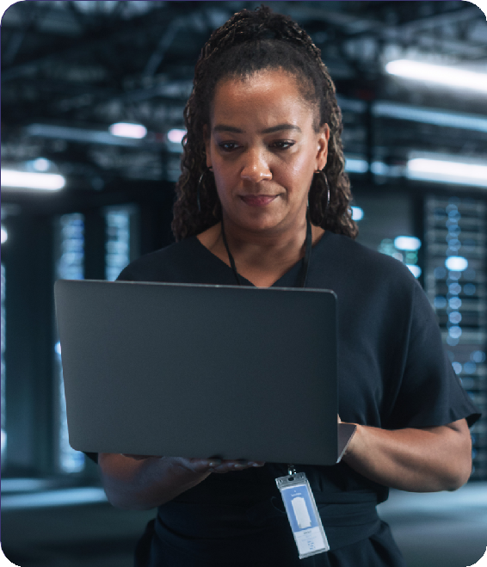
Career Progression & Development
Kneat is committed to fostering inclusive long-term careers at the Company and
to invest in the growth and development of all team members through learning and development initiatives.
In 2025/26, female team members represented 65% of participants in Kneat- sponsored learning and development programs.
Kneat has continued to partner with University College Dublin to support team members aspiring to leadership roles the opportunity to complete the Professional Academy Diploma in Leadership & Management.
Kneat launched its first Graduate Rotation Programme in 2023, the initial group have since transitioned into permanent roles and are actively contributing to the business. The Company continues to hire graduates annually across multiple departments, reflecting Kneat’s continued investment in developing early career talent, gender diversity and supporting long-term career development.
During 2026, Kneat sponsored team members on the American Chamber of Commerce’s Women in Global Organisations Peer Mentoring program and Emerging Leaders Programme. Currently, females represent 75% of participants in these programmes, promoting progression through targeted initiatives that enable sharing insights, exploring practices, and gaining new perspectives.
Copyright ©2025. All rights reserved.
6

Slide 7

Work-Life Balance & Wellbeing
Kneat promotes a supportive work environment that empowers team members
to prioritise their wellbeing while effectively balancing professional responsibilities and personal commitments.
Our hybrid work model provides flexibility to manage both personal and professional responsibilities.
Family Leave Policies are available to all employees across Kneat. Kneat offers paid maternity leave to female team members and is committed to supporting female team members returning from maternity leave reinforcing our dedication to retaining and advancing female talent.
Our comprehensive benefits packages includes health insurance for team members and dependents, death in service, income protection, and an extensive fertility package available through our health insurance provider as well as an Annual Fitness Allowance.
Kneat also supports several initiatives throughout the year with dedicated webinars and information sessions across a range of topics from Mental Health, Pride Month, and Cancer Awareness. Every two years, Kneat provides onsite heart screening to employees via our health insurance provider.
Copyright ©2025. All rights reserved.
7

Slide 8

Employee Resource Groups
Kneat has established two Employee Resource Groups (ERGs) which are key pillars in creating a diverse and inclusive culture. These groups are voluntary employee-led groups focussed on a shared interest which aim to foster a diverse and inclusive workplace.
The Women in Action ERG Provides an inclusive space for employees to connect, share their perspectives, and drive actions to enable women at Kneat to grow and thrive with support from both men and women. The WIA ERG remain committed to leading and planning further initiatives in the future including:
Career Journey Learning Session
Networking Events & Connecting with ERGs at local Companies.
International Women’s Day Celebration
The Early Career ERG is dedicated to accelerating the growth and impact of young and early career professionals by accelerating their development and impact. This ERG will help Kneat attract and retain young and early career professionals at the Company. The Early Career ERG provides a voice for
the EC members and hosts social events, career talks, guest speakers and networking opportunities to foster connection and growth.
Copyright ©2025. All rights reserved.
8

Slide 9

Talent Acquisition
At Kneat, our talent sourcing and selection is focused on candidate skills, qualifications, and experience in line with the requirements of each role.
We believe in hiring the right candidate regardless of their characteristics, including gender.
We continue to evolve our hiring practices to ensure fairness and inclusivity and will continue our focus on ensuring we use gender-neutral job descriptions, implementing standardised interview questions to compare candidates, and, where feasible, use diverse interview panels, particularly for Senior roles.
To further support hiring, HR team members and people managers receive a standard training session before engaging in the TA Process which highlights unconscious bias, helping them make objective decisions.
Kneat is committed to developing early career talent by partnering with local universities to attract top graduates, while actively promoting STEM disciplines and increasing female participation in our Graduate Programme.
Copyright ©2025. All rights reserved.
9

Slide 10


Our Annual Gender Pay Gap Report is an important part of Kneat’s Diversity and Inclusion Strategy, reinforcing our commitment to supporting career growth and equity.
Improving gender balance while hiring the best talent remains a priority. In 2026, we continued to advance the initiatives outlined in this report – providing development opportunities, resources, and a culture that supports progression.
We hope this report reflects our investment in creating an inclusive workplace where all team members can grow, develop, and contribute to our mission.
Copyright ©2025. All rights reserved.
10

Slide 11



Thank You
T: +353 (0)61 203826
E: info@kneat.com W: kneat.com
Hawthorn House
Plassey Business Campus, Castletroy, Co. Limerick, V94 5F68,
Ireland
@KneatSolutions
@KneatSoftware

